Slide 1

Microsoft Project Oxford: Adding Smarts to Your Applications
Jason Poon (@jasonthepoon) Software Engineer, Microsoft

Slide 2
Agenda
?
?
Introduction
What is Project Oxford?
Oxford in Action
Questions
?
?

Slide 3




What is Project Oxford?
Artificial intelligence for the masses
A portfolio of free* artificial intelligence based speech, vision, language APIs
Models are trained using the same deep learning and machine learning techniques that power many products across Microsoft

Slide 4





Microsoft Project Oxford Services
PROJECT OXFORD
Vision
Vision APIs
Face APIs
Emotion APIs
Video APIs
Speech
Speech APIs
Speaker Recognition
CRIS (Custom Recognition Intelligent Service)
Language
Spell Check APIs
LUIS
(Language Understanding Intelligent Service)

Slide 5
Microsoft Project Oxford Services
PROJECT OXFORD
Vision
Vision APIs
Face APIs
Emotion APIs
Video APIs
Detect Emotions
Analyze Image
Face Detection
Stabilization
OCR
Face Grouping
Face Detection and Tracking
Generate Thumbnail
Face Identification
Motion Detection
Notes:
Analyze Image – image categories (clip-art, line drawing)/pornographic detection/dominate color
OCR
Generate Thumbnail – smart cropping to preserve the region of interest
Face Detection – detect human faces and attributes (face landmarks, pose), and ML based predictions of gender and age
Face Grouping – organize many faces into face groups based on their visual similarity
Face Identification – match a face with a name
Emotion- emotions are cross-cultural and universally communicated. ML based prediction of subject’s emotion
Video – smooth and stabilize shaky video
Face Detection and Tracking – foreach video frame
Motion Detection – analyze video inputted and output metadata for which frames motion is detected

Slide 6
Microsoft Project Oxford Services
PROJECT OXFORD
Speech
Speech APIs
Speaker Recognition
CRIS (Custom Recognition Intelligent Service)
Speech Recognition
Speaker Verification
Custom Language Models
Text to Speech
Speaker Identification
Custom Acoustic Models
Speech Intent Recognition
Improve Models
Notes:
Speech recognition – convert spoken audio to text (real time streaming)
Text to Speech – convert text to spoken audio
Speech Intent Recognition – audio -> text -> intent
Speaker Verification – use your voice for authentication
Speak Identification – who is speaking?
CRIS – creating custom speech recognition tailored to application’s environment, users population, and vocabulary

Slide 7
Microsoft Project Oxford Services
PROJECT OXFORD
Language
Spell Check APIs
LUIS
(Language Understanding Intelligent Service)
Word breaking
Determine Intent
Detects Homonyms
Determine Entities
Support for phrases as they emerge
Improve Models
Notes:
Spell Check
LUIS – pre-existing, pre-built models or build specialized models to better understand the intent of users

Slide 8






Project Oxford across Microsoft
PROJECT OXFORD
Vision APIs
Face APIs
Speech APIs
Spell Check
LUIS
(Language Understanding Intelligent Service)
Speech
Spell Check
LUIS
Skype
Office
Windows
Cortana
Bing
Xbox
Notes:
Office Lens

Slide 9
Microsoft Project Oxford Services
PROJECT OXFORD
Vision
Vision APIs
Face APIs
Emotion APIs
Video APIs
Speech
Speech APIs
Speaker Recognition
CRIS (Custom Recognition Intelligent Service)
Language
Spell Check APIs
LUIS
(Language Understanding Intelligent Service)

Slide 10





Where can I get it?
Computer Vision
Face
Emotion
Video
Speech
Speaker Recognition
Computer Vision
Face
Emotion
Speech
Speech
Client SDK
REST API
Computer Vision
Face
Emotion
Video
Computer Vision
Face
Emotion

Slide 11
Let’s build something

Slide 12
Vision APIs
Analyze an Image
OCR

Slide 13
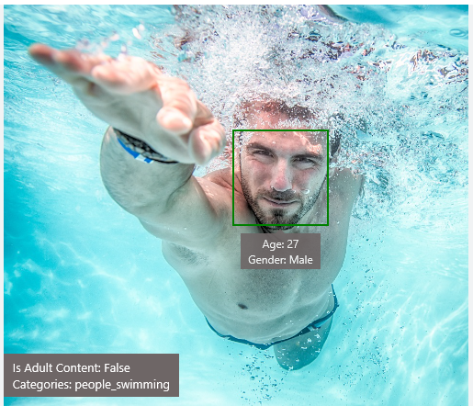
Analyze Image – Example
Type of Image:
Clip Art Type 0 Non-clipart
Line Drawing Type 0 Non-Line Drawing
Black & White Image False
Content of Image:
Categories [{ “name”: “people_swimming”, “score”: 0.099609375 }]
Adult Content False
Adult Score 0.18533889949321747
Faces [{ “age”: 27, “gender”: “Male”, “faceRectangle”: {“left”: 472, “top”: 258, “width”: 199, “height”: 199}}]
Image Colors:
Dominant Color Background White
Dominant Color Foreground Grey
Dominant Colors White
Accent Color

Slide 14

OCR – Example
TEXT:
LIFE IS LIKE
RIDING A BICYCLE
TO KEEP YOUR BALANCE
YOU MUST KEEP MOVING
JSON:
{
"language": "en",
"orientation": "Up",
"regions": [
{
"boundingBox": "41,77,918,440",
"lines": [
{
"boundingBox": "41,77,723,89",
"words": [
{
"boundingBox": "41,102,225,64",
"text": "LIFE"
},
{
"boundingBox": "356,89,94,62",
"text": "IS"
},
{
"boundingBox": "539,77,225,64",
"text": "LIKE"
}
. . .

Slide 15
Demo
Notes:
https://how-old.net/

Slide 16
Face APIs
Detection
Verification

Slide 17
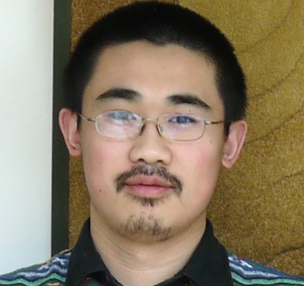
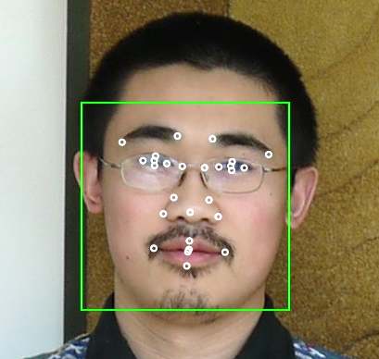
Face API – Detection
Detection Result:
JSON:
[
{
"faceRectangle": {
"width": 109,
"height": 109,
"left": 62,
"top": 62
},
"attributes": {
"age": 31,
"gender": "male",
"headPose": {
"roll": "2.9",
"yaw": "-1.3",
"pitch": "0.0"
}
"faceLandmarks": {
"pupilLeft": {
"x": "93.6",
"y": "88.2"
},
"pupilRight": {
"x": "138.4",
"y": "91.7"
},
...
DETECTION
ATTRIBUTES
INPUT IMAGE
FACIAL RECTANGLE + LANDMARKS

Slide 18
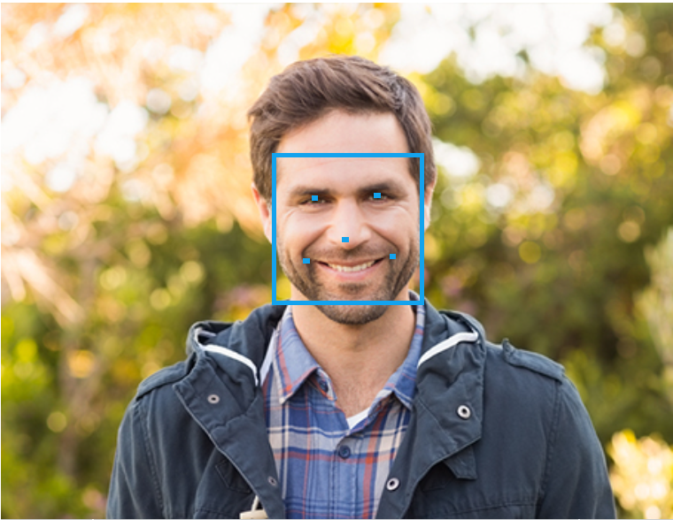
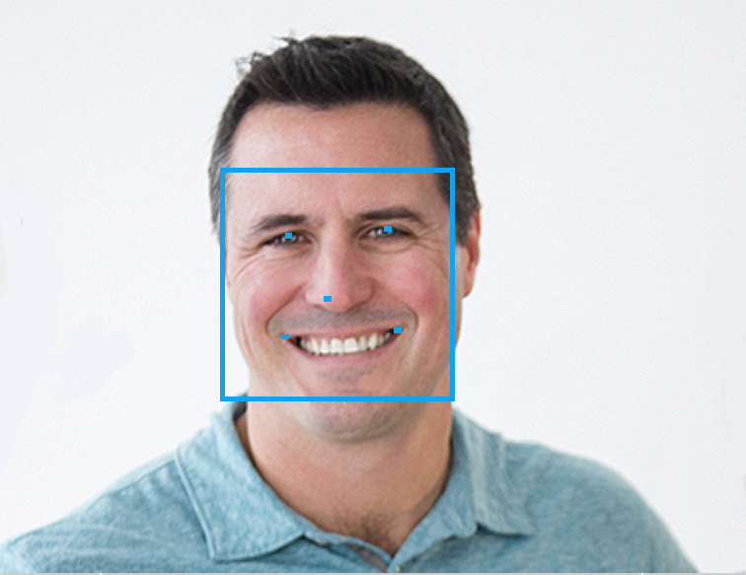
Face API – Verification
Given two faces, determine whether they are the same person
Verification Result:
JSON:
[
{
"isIdentical":false,
"confidence":0.01
}
]

Slide 19
Demo
Notes:
https://www.mymoustache.net/

Slide 20
Language Understanding Intelligent Service
Determine Intent
Detect Entities
Improve Models

Slide 21
Language Understanding Intelligent Service
Lets you understand what your users are saying
Seamless integration with Speech Recognition
A few examples are enough to deploy an application
LUIS learns over time
Define
Concepts
Provide
Examples
Deploy
Active Learning

Slide 22
Language Understanding Models
{
“entities”: [
{
“entity”: “flight_delays”,
“type”: “Topic”
}
],
“intents”: [
{
“intent”: “FindNews”,
“score”: 0.99853384
},
{
“intent”: “None”,
“score”: 0.07289317
},
{
“intent”: “ReadNews”,
“score”: 0.0167122427
},
{
“intent”: “ShareNews”,
“score”: 1.0919299E-06
}
]
}
“News about flight delays”

Slide 23
Demo
Notes:
SpotifySearch

Slide 24
In Review
Visit https://www.projectoxford.ai
Sign in using your Microsoft Account
Go to your subscriptions (https://www.projectoxford.ai/Subscription)
Request a new key for the product you want
You now have your developer keys, ready to use in your applications

Slide 25
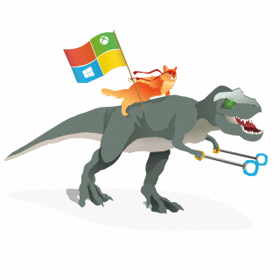




thanks for listening
Jason Poon github.com/jpoon
@jasonthepoon
jason.poon@microsoft.com

